Slide 1
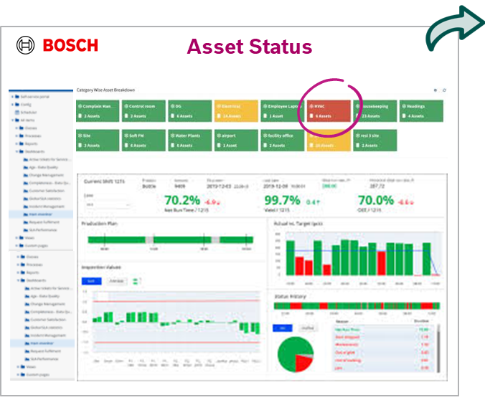
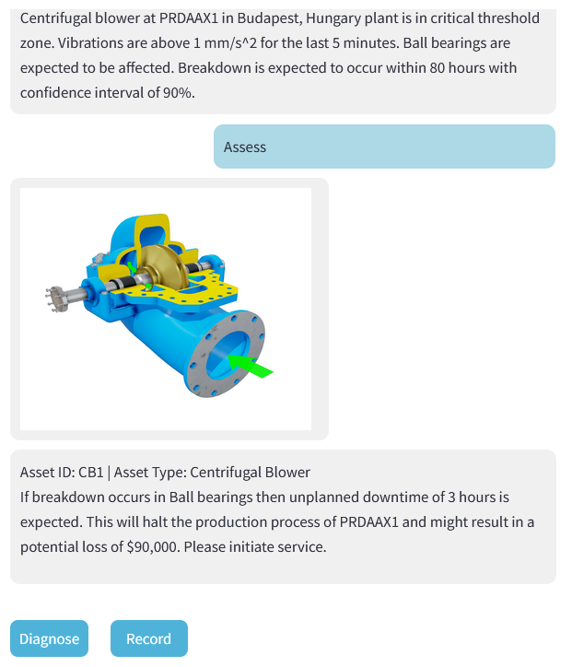

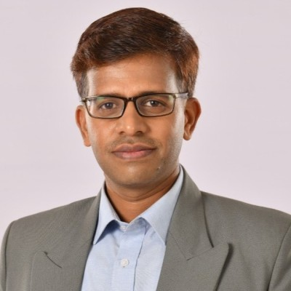
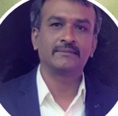




‘Know-it-all’ Gen AI Brain for Manufacturing
IndAIGenious by Bosch
Voice of Customers:
“We are interested in AI solutions that can be integrated with Nexeed IAS and offer significant competitive advantage”
Norbert Jung (BCI/P)
“Downtime is a very important KPI that we are actively trying to address through AI driven solutions”
Subhash P (NhP1/TEF)
“We are interested in piloting IndAIGenious for BidP with the expectation of having efficiency gains”
Keshavamurthy N L (BidP1/TEF4)
With validations from global leaders:
Team (SX/EDS)
The Era of Smart‘er’ Manufacturing is here.

